Slide 1













Slide 2



Slide 3
Vision
Making host-atendee interaction simple.
Notes:
Making host-atendee interaction simple. Users post relevant questions and the audience can vote and reply. The talk's host may answer the most popular ones.

Slide 4

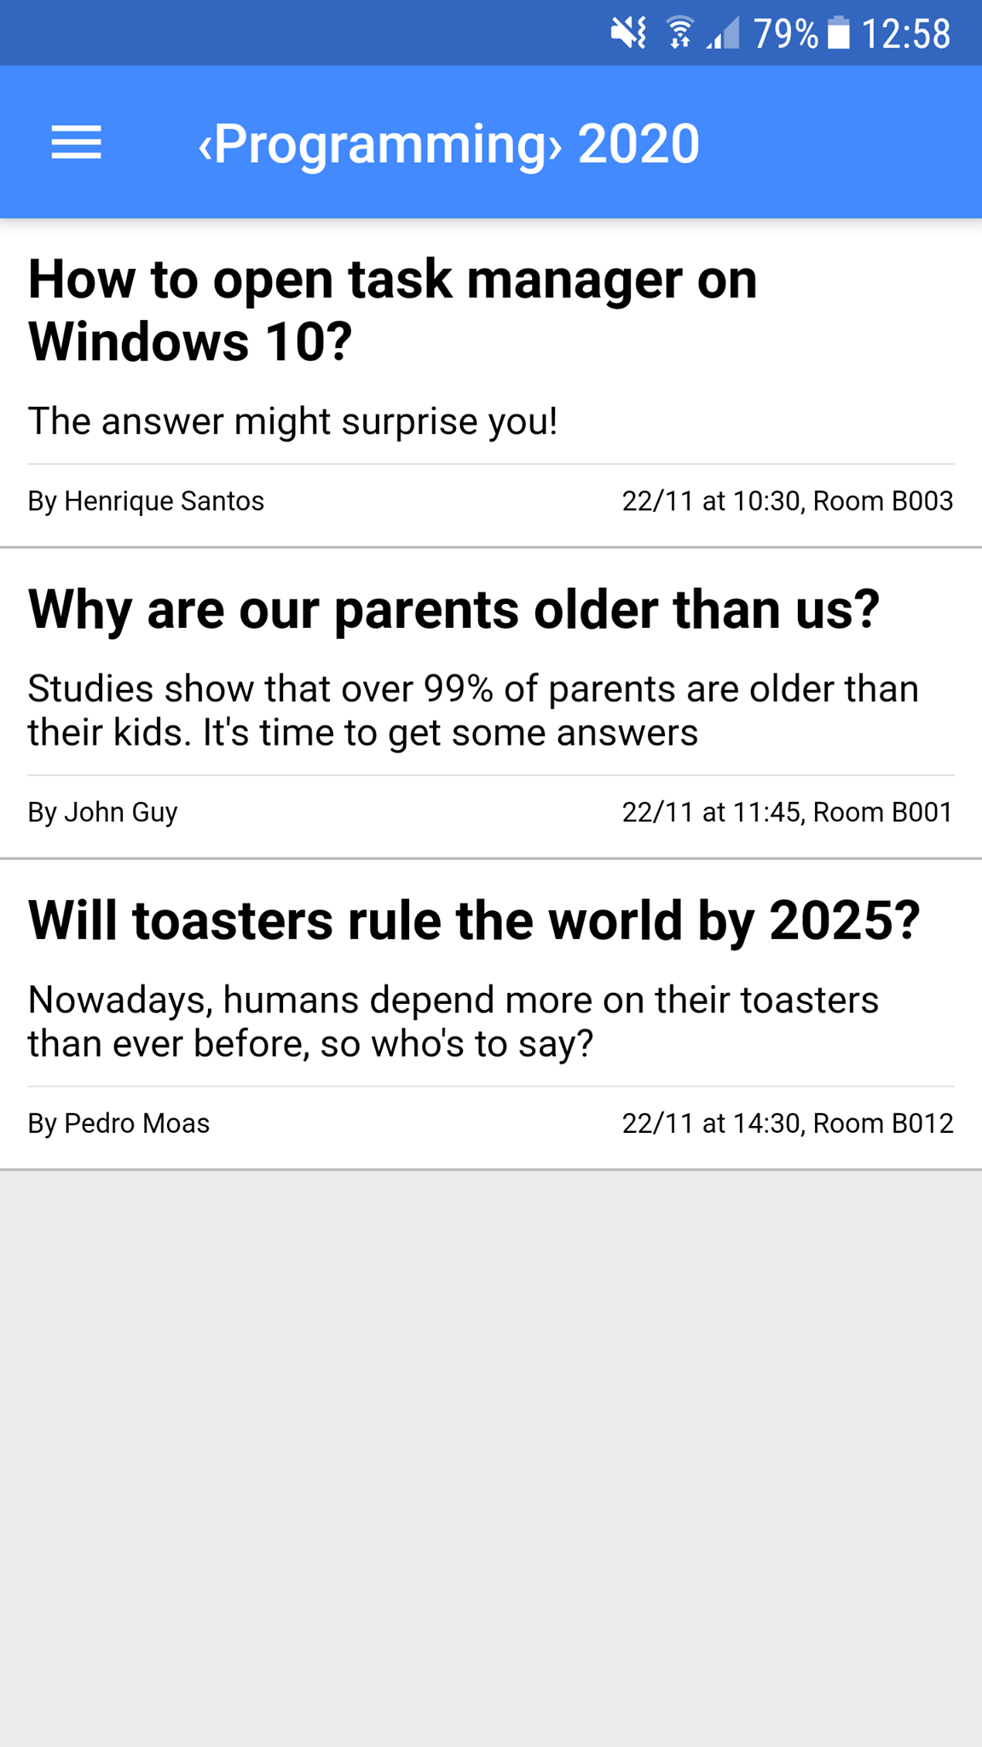
Core features
Talk listing
Notes:
- Lista de talks
- Em cada talk todos podem criar perguntas
Utilizadores podem votar em perguntas e responder se quiser
Perguntas sao ordenadas por número de votos p/ hosts escolherem

Slide 5

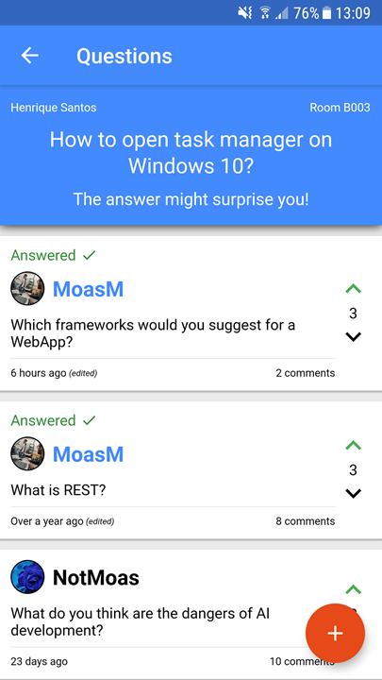
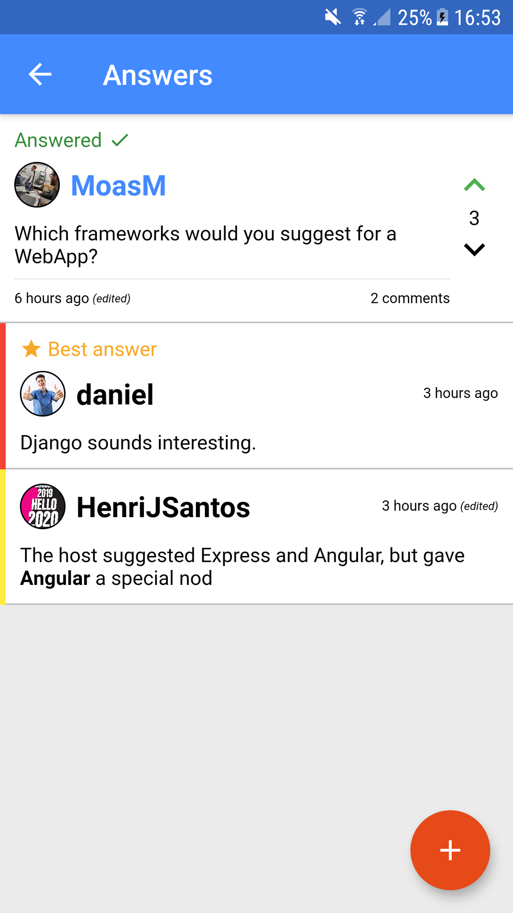

Core features
Raise questions and vote for the best ones
Answer other’s questions!
Notes:
- Lista de talks
- Em cada talk todos podem criar perguntas
Utilizadores podem votar em perguntas e responder se quiser
Perguntas sao ordenadas por número de votos p/ hosts escolherem

Slide 6
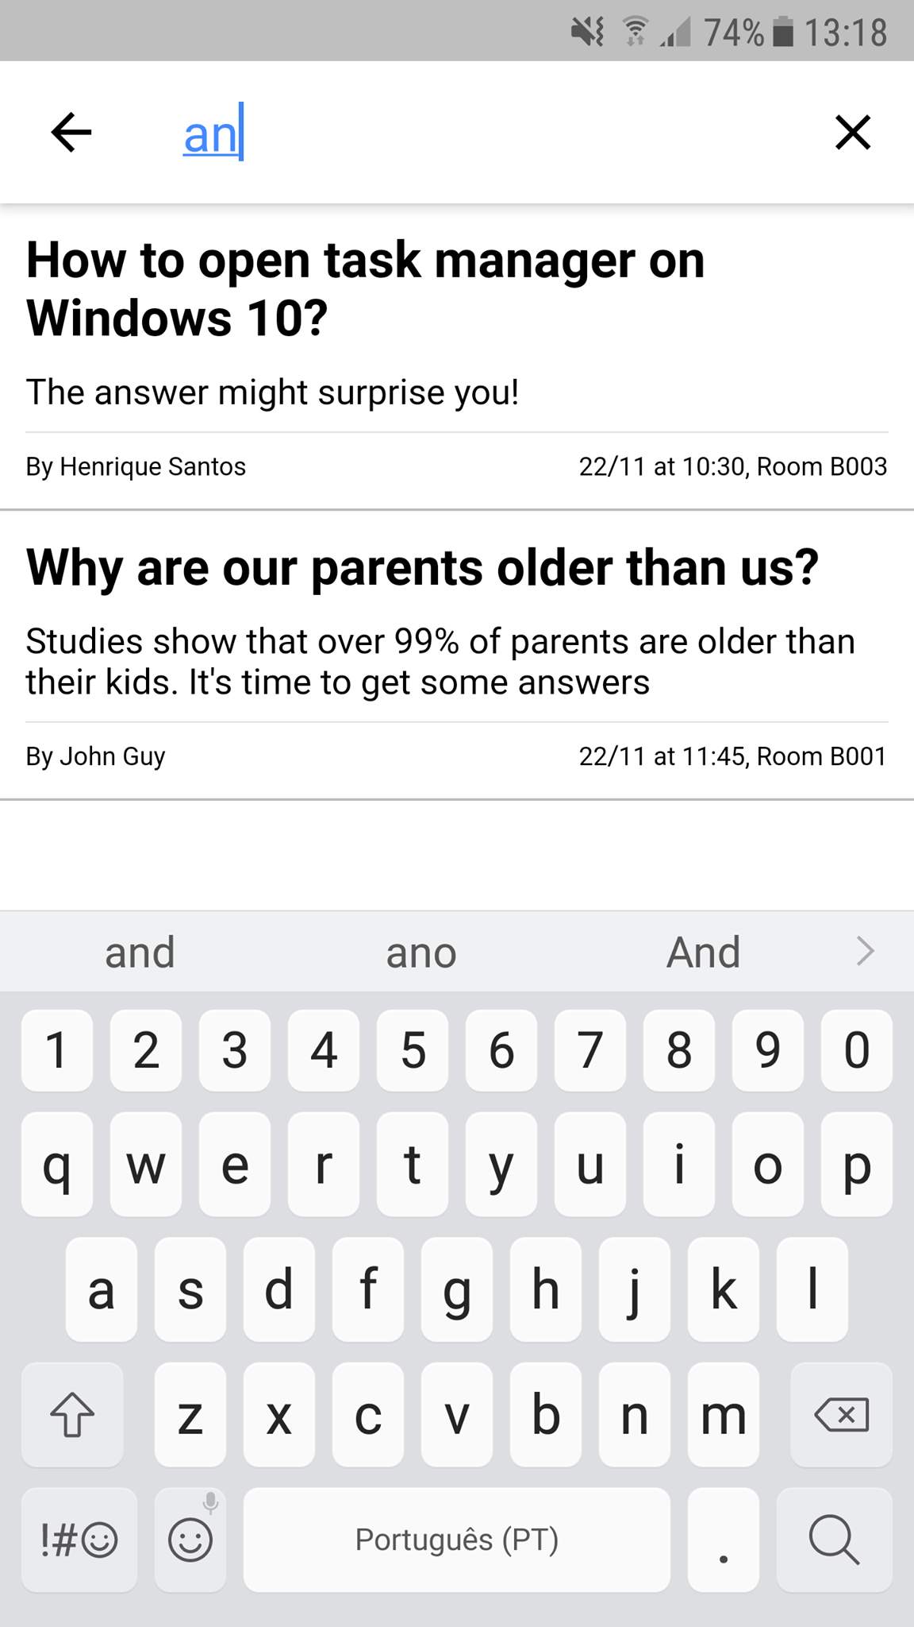
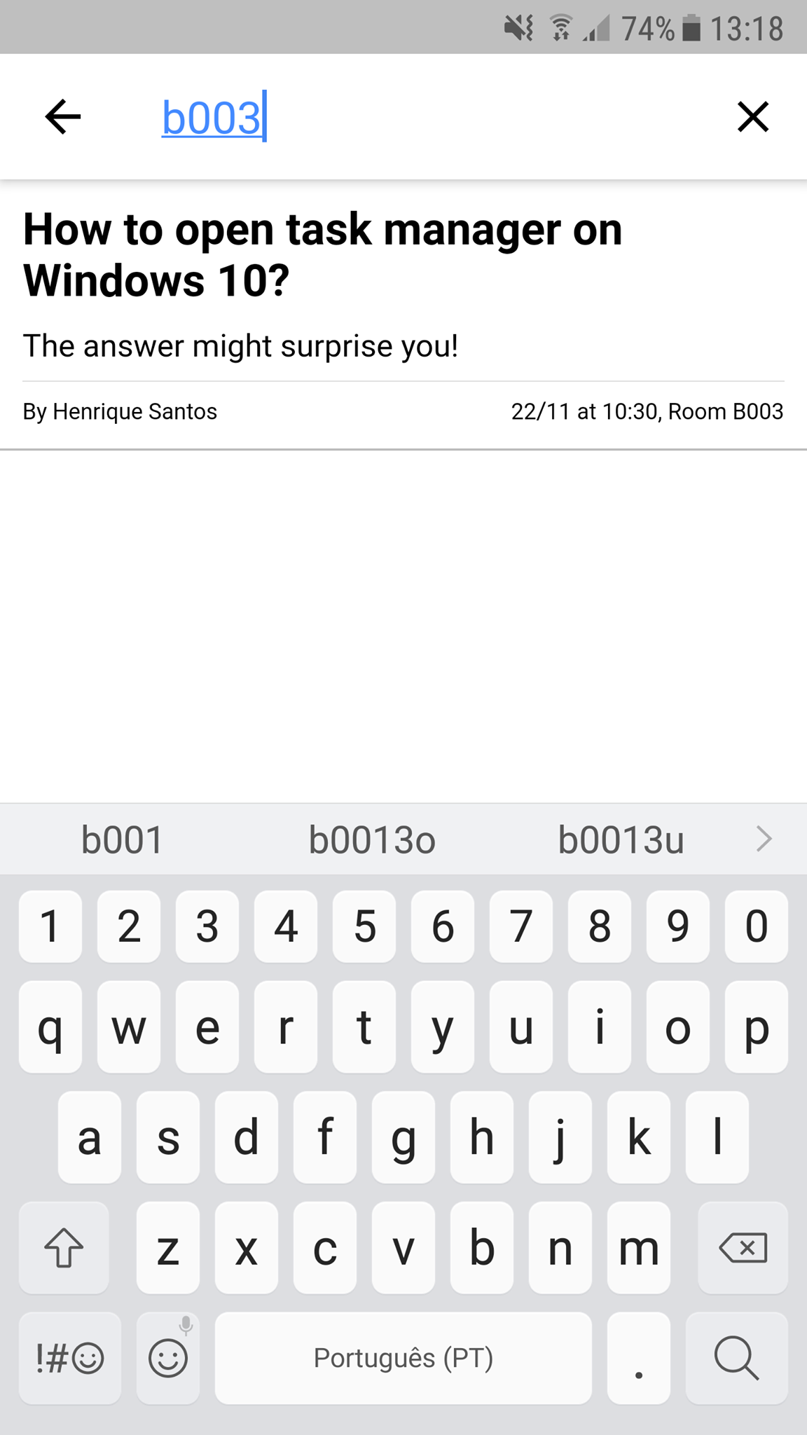

Other features
Search for talks near you
Notes:
- Lista de talks
- Em cada talk todos podem criar perguntas
Utilizadores podem votar em perguntas e responder se quiser
Perguntas sao ordenadas por número de votos p/ hosts escolherem

Slide 7
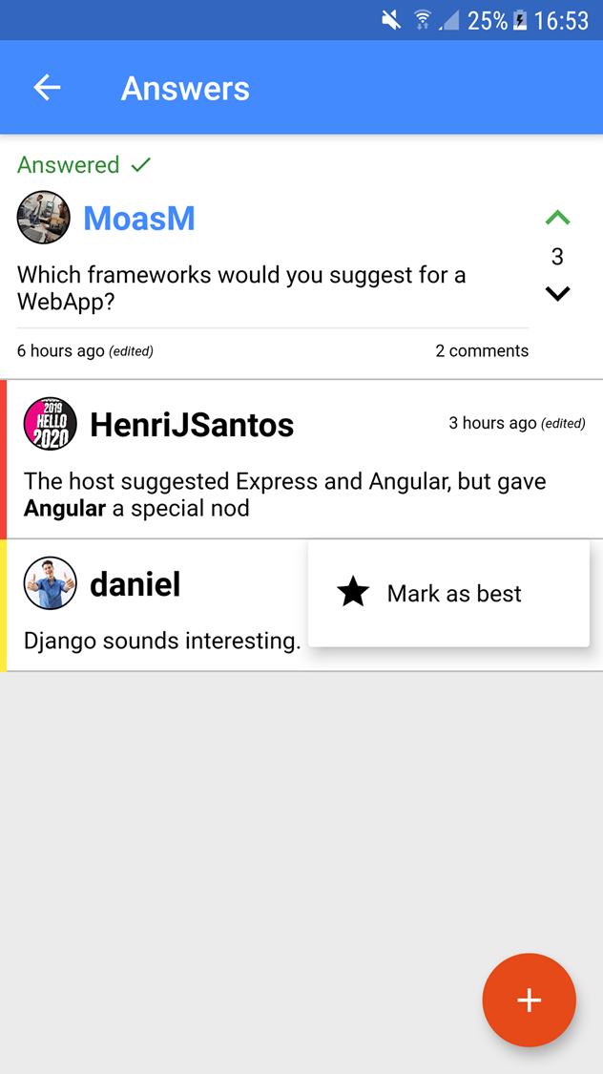

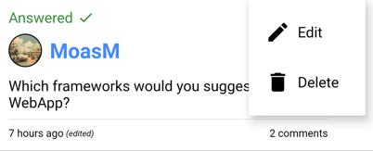


Other features
Mark the question as answered
Edit / Delete your comments
Pin the best answers

Slide 8

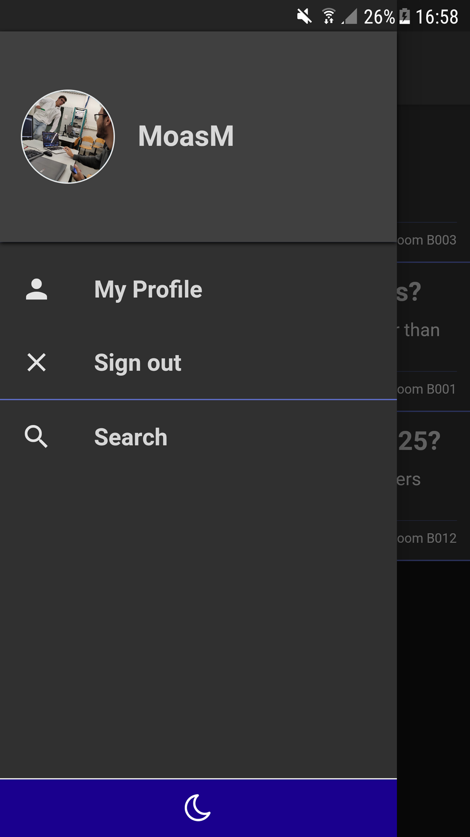
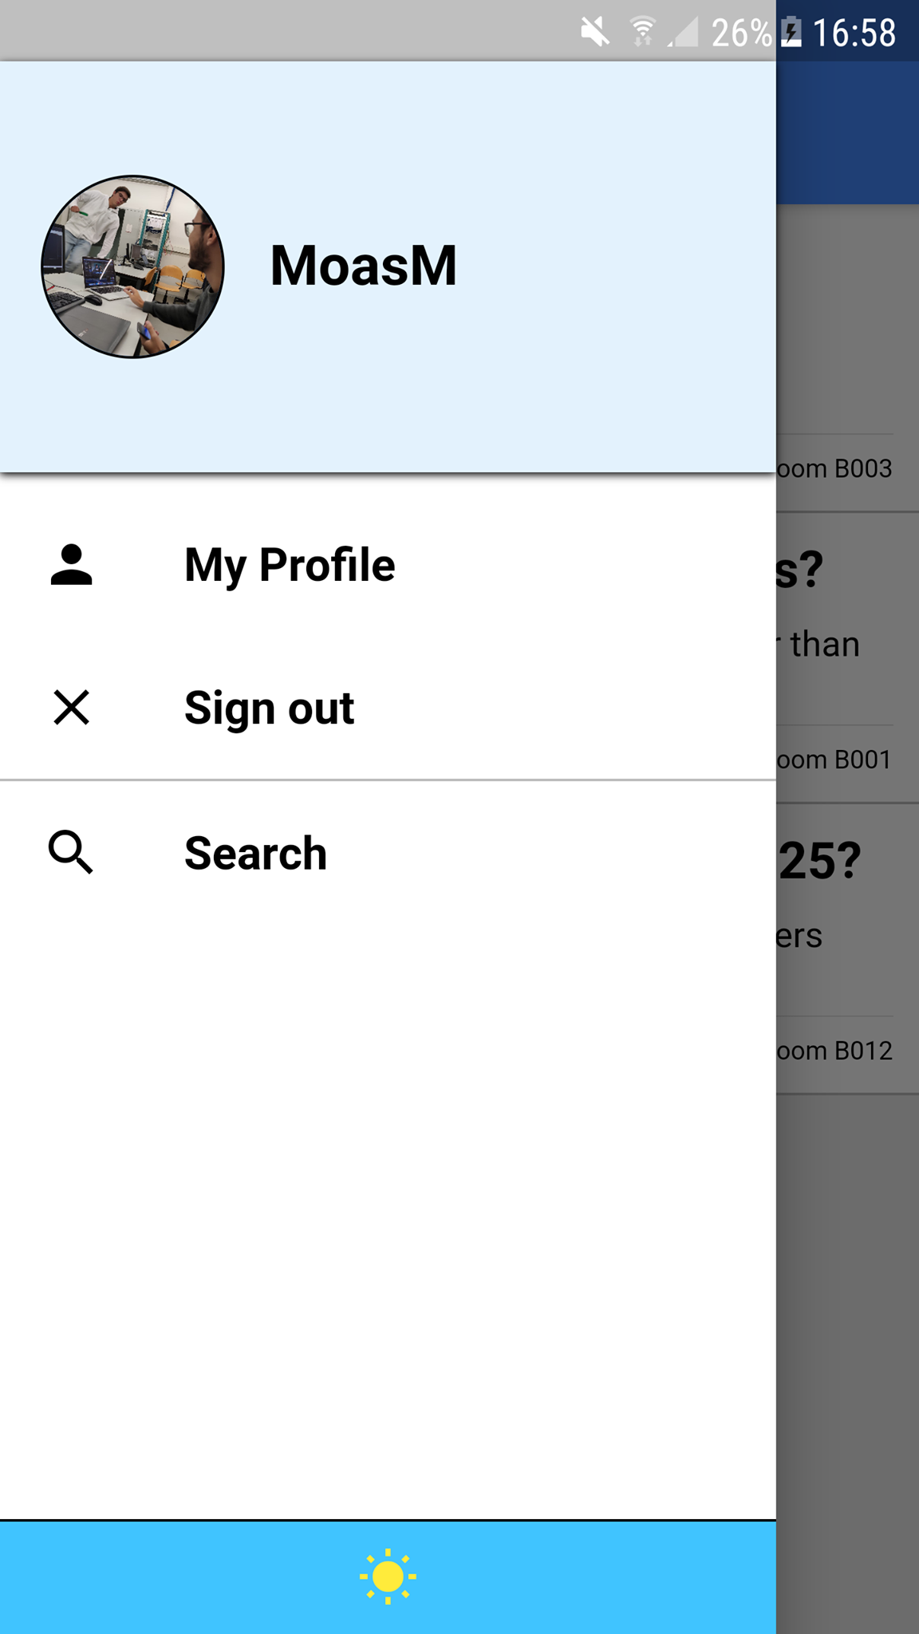
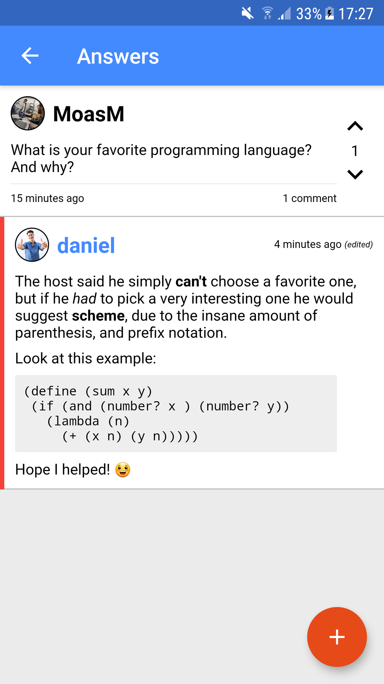
The best ux
Dark mode
Markdown support
Auto sign-in
Swipe to refresh
…And many more!
Notes:
- Others:
Custom messages for empty question / answer lists
Admin status: Can delete comments and create talks
Adaptive date display / Comment count
Comment discard prevention
Auto upvote own questions
Keyboard opens automatically when adding/editing comment

Slide 9
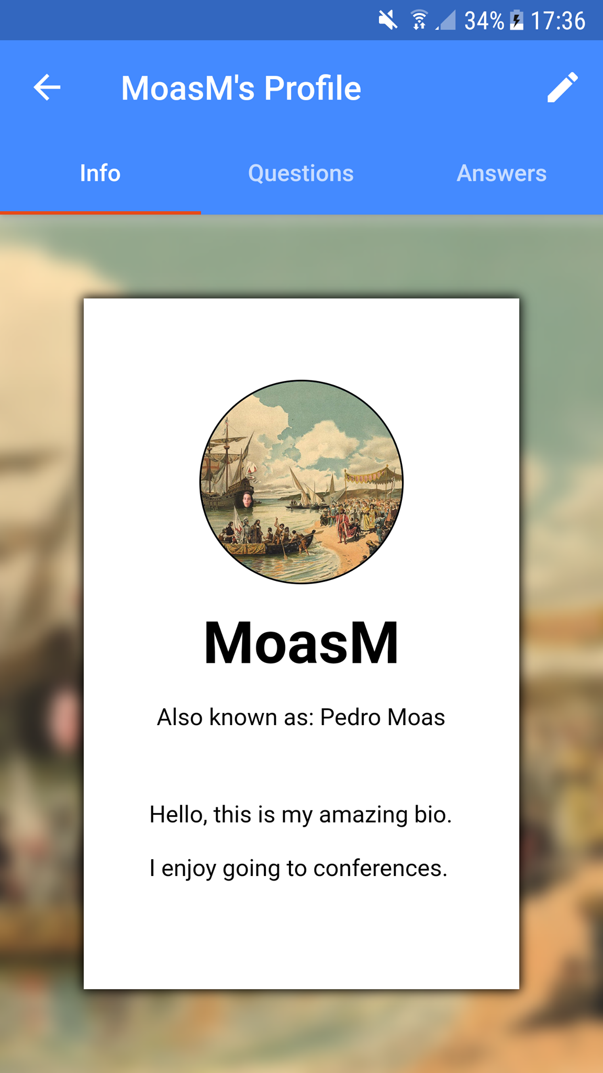
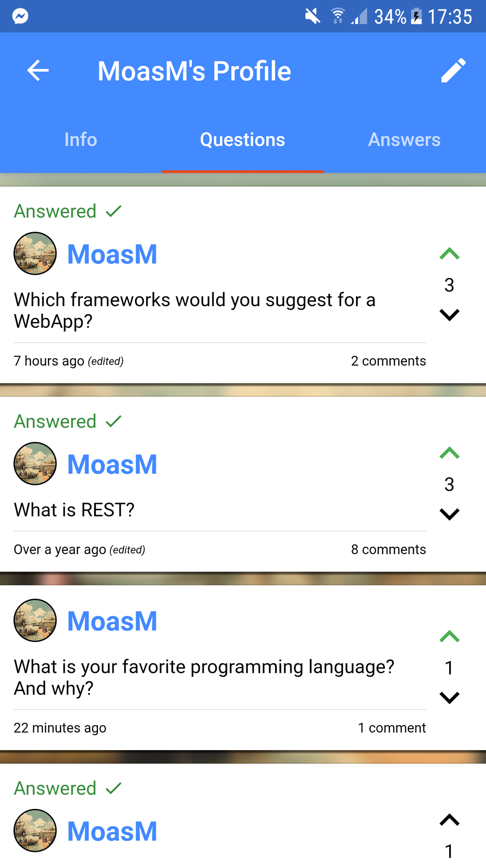



Customizable Profile
Edit account information
Choose your own bios
List your comments

Slide 10
Askkit
Coming to you soon on both android and iOS

